Slide 1


Analyzing E-Commerce Product Trends Using Shopify and Social Commerce Data
By: Taylor Duncan
File: shopify_trending_products_2025.csv
Code: https://github.com/taylorduncan/dsc680.git

Slide 2

Business Problem
Highly saturated and competitive e-commerce market
Product decisions often based on intuition or viral trends
Poor selection increases inventory and revenue risk
Need for data-driven product and pricing insights

Slide 3
Dataset & Methods
Dataset : Shopify & social commerce trend data
  Categories, revenue, price range, trend score
Methods
  Exploratory Data Analysis (EDA)
  Linear Regression
  Random Forest Regression
  Model evaluation: RMSE, MAE, R²

Slide 4
Exploratory Analysis
Revenue distribution across categories
Trend score vs. revenue relationship
Pricing patterns among high performers
Identification of early performance signals

Slide 5
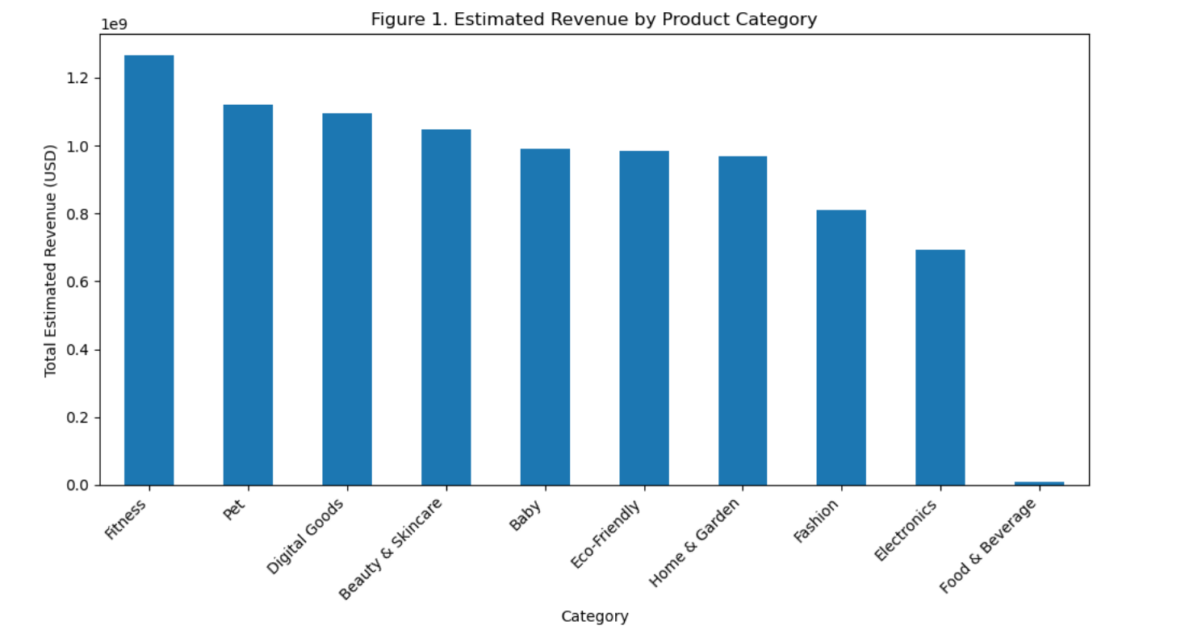

Slide 6
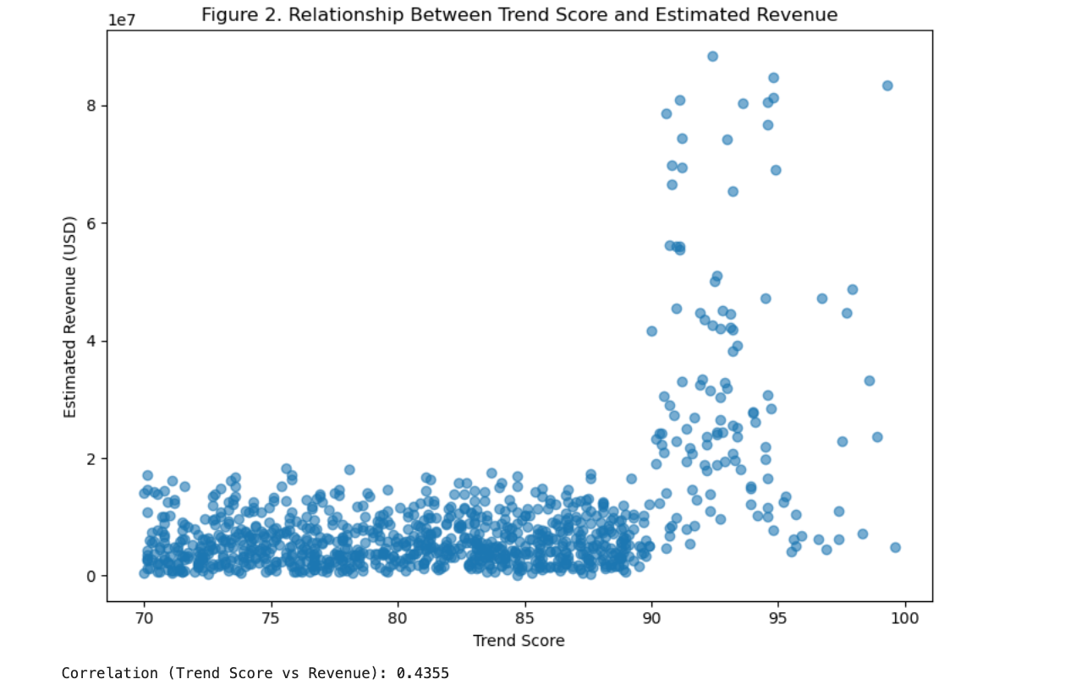

Slide 7
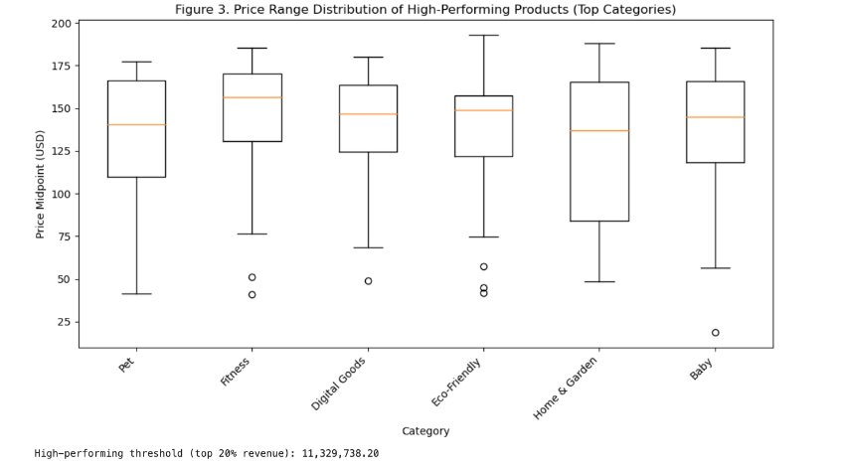

Slide 8
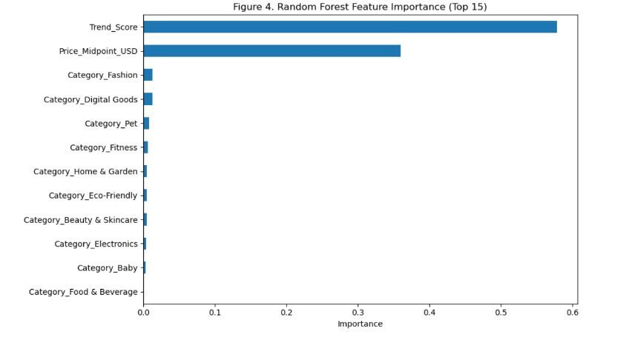

Slide 9
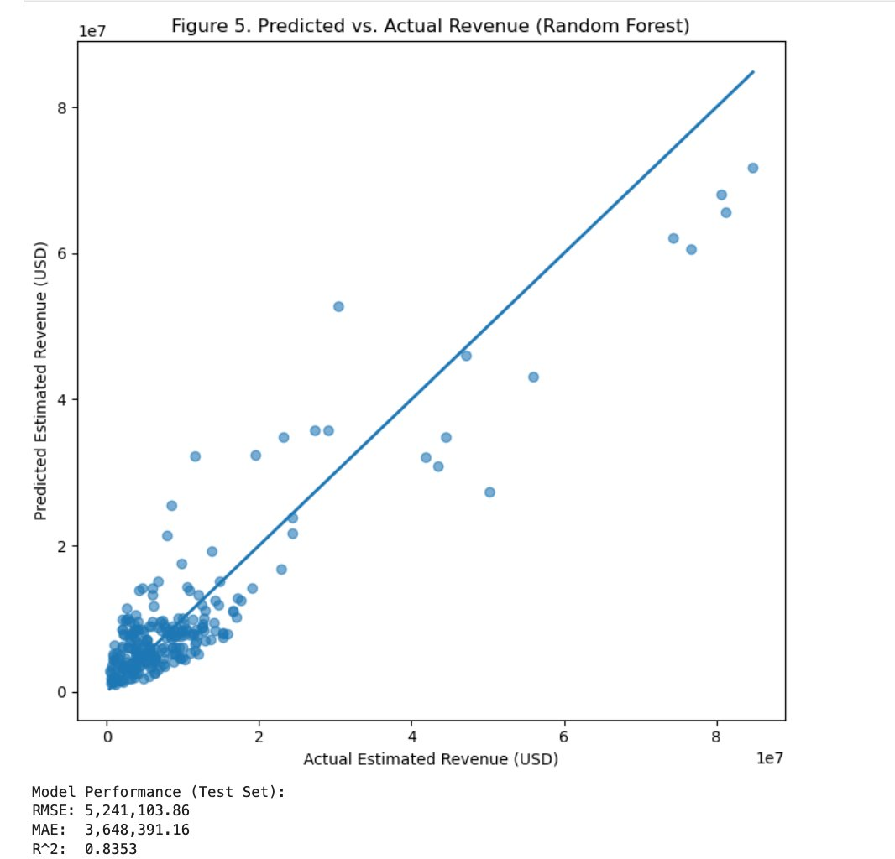

Slide 10
Conclusions & Recommendations
Trend score + pricing drive revenue performance
Random Forest outperforms linear regression
Mid-priced, high-trend products are strongest candidates
Use analytics to reduce product risk

Slide 11
Future Uses and Applications
Incorporate seasonality and time-series data
Add marketing spend and engagement metrics
Automate monitoring pipelines
Support inventory and product planning

Slide 12

Q/A
Q1. How reliable are the estimated revenue figures for real-world investment decisions?
A: They are suitable for relative comparison and trend analysis but not for precise financial forecasting.
Q2. Can trend score predict long-term product success or only short-term demand?
A: Trend score reflects short- to medium-term demand and should be combined with longitudinal data.
Q3. How often should this analysis be updated to remain actionable?
A: Monthly or quarterly updates are recommended.
Q4. What role does seasonality play in trend-driven products?
A: Seasonality likely has significant impact and should be modeled using time-series methods.
Q5. How transferable are these findings across geographic markets?
A: Patterns may vary by region and should be validated locally.
Q6. Can this framework be automated for continuous monitoring?
A: Yes, through scheduled data ingestion and retraining pipelines.
Q7. How would marketing spend alter these results?
A: Marketing spend would likely amplify revenue and should be included as a predictor.
Q8. What risks exist in over-optimizing trend-based products?
A: Over-reliance on trends may lead to short-lived success and inventory risk.
Q9. How can small businesses implement this analysis with limited resources?
A: Yes, simplified versions can be built using open-source tools.
Q10. How does this approach compare to traditional market research methods?
A: This approach is faster, scalable, and continuously updatable compared to survey-based methods.

